Slide 1
Macroeconomic Issues and Concepts

Slide 2
Outline
Macroeconomic issues
Macroeconomic concepts
Stock and Flow variables:
A stock is measured at one specific time, and represents a quantity existing at that point in time (say, December 31, 2019), which may have accumulated in the past.
Examples: Wealth, Foreign Debts, Loan, Inventories (not change in inventories), Opening stock, Money Supply (Amount of Money), Population, etc.
A flow variable is defined with reference to a specific period (length of time), e.g., hours, days, weeks, months or years. It has time dimension.
Examples: National Income, Investment, expenditure, savings, depreciation, interest, exports, imports, change in inventories (not mere inventories), change in money supply, rent, profit, etc. because magnitude (size) of all these are measured over a period of time.
Equilibrium vs. Disequilibrium
Partial vs. General Equilibrium Analysis
Static, Comparative Static and Dynamic Analysis

Slide 3
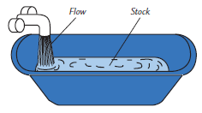
STOCK AND FLOW VARIABLES
The stock variables refer to the quantity or value of certain economic variables given at a point in time, e.g., on 31st March 2006 or 31st December 2007.
The flow variables are the variables that are expressed as a rate per unit of time, e.g., per hour, per week, per month, or per year.
Stocks and Flows: The amount of water in a bathtub is a stock: it is a quantity measured at a given moment in time. The amount of water coming out of the faucet is a flow: it is a quantity measured per unit of time.

Slide 4
STOCK AND FLOW VARIABLES
The water accumulated in a lake is a stock; the quantity of water flowing in or flowing out per unit of time is a flow.
Monthly provision of sugar in a household is a stock and quantity of sugar consumed per day is a flow.
A person’s wealth is a stock; his income and expenditure are flows.
The number of unemployed people is a stock; the number of people losing their jobs is a flow.
The amount of capital in the economy is a stock; the amount of investment is a flow.
A fixed deposit with a bank is a stock; interest earned on the deposit, e.g., monthly or annual interest income, is a flow.

Slide 6
Equilibrium vs. Disequilibrium
Equilibrium refers to a state or situation in which opposite economic forces, e.g., demand and supply, are in balance and there is no in-built tendency to deviate from this position.
Disequilibrium is the absence of a stale of balance—a state in which opposing forces produce imbalance.
Partial vs. General Equilibrium Analysis
Partial Equilibrium is based on two assumptions:
Ceteris Paribus
Other sectors are not affected due to change in one sector
General Equilibrium is based on the assumptions:
Various sectors are mutually interdependent.
There is an effect on other sectors due to change in one.

Slide 7
Static, Comparative Static and Dynamic Analysis

Slide 8
MACROECONOMIC ISSUES
Achieving and maintaining a high rate of economic growth,
Preventing business cycles,
Controlling inflation and stabilizing price level,
Problems of unemployment,
Containing growing budgetary deficits, and
Managing international economic issues.

Slide 9
1) Growth related issues
(i) How to maintain the current high growth rate; and
(ii) How to prevent the overheating of the economy—a problem often associated with fast growing economies
Notes:
Achieving and maintaining a high growth rate has been a matter of concern for both developed and developing economies. This in turn raises their standard of living.
EMEs faced the problems of how to accelerate the pace of their growth, how to generate adequate savings from the low levels of income, how to increase the rate of capital formation, and investment oppurtunities and so on.
Overheating of an economy occurs when its productive capacity is unable to pace with growing aggregate demand.

Slide 10
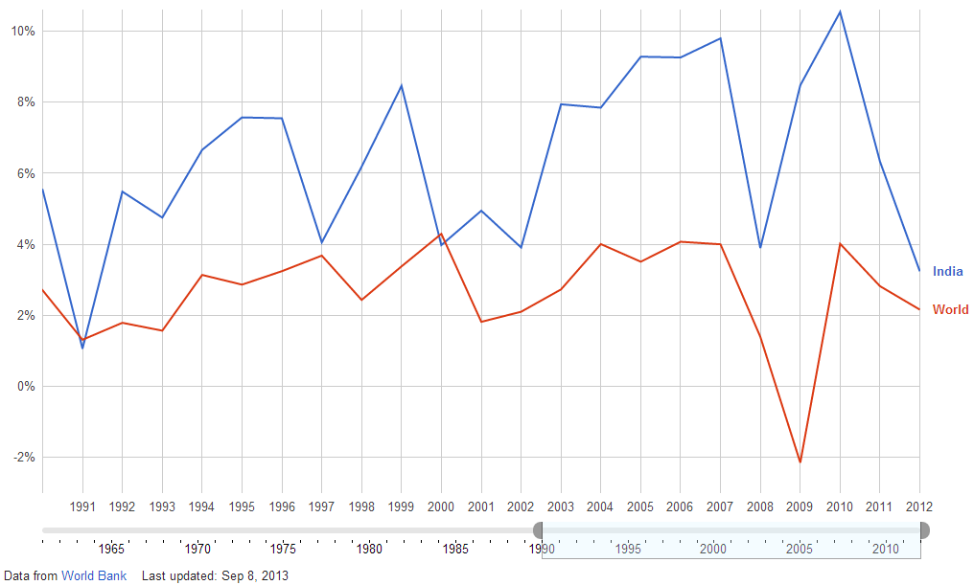
GDP Growth rate (%)

Slide 11
2) The Issues of Business Cycles
Business cycle refers to high magnitude of fluctuation in the economy—high growth in GDP/GNP in one period followed by a sharp decline in the next period.
During boom and prosperity, there is high rate of growth in GDP and high rate of employment, and
During depression, there is fast decline in GDP and high rate of unemployment.
The forces of business cycles are always present in growing economies, and the government and the policy makers of the country have to be on their guards to take action, if necessary, for preventing the business cycles.
Notes:
Ups and downs, booms and slumps, prosperity and depression in macro economy represents business cycles.
Example of business cycles are Great Depression of 1930s, Asian Financial crisis of 1997-98, Global financial crisis of 2008.
Phases of business cycles: 1) Expansion 2) Contraction- i) Recession, ii) prolonged recession called depression.

Slide 12
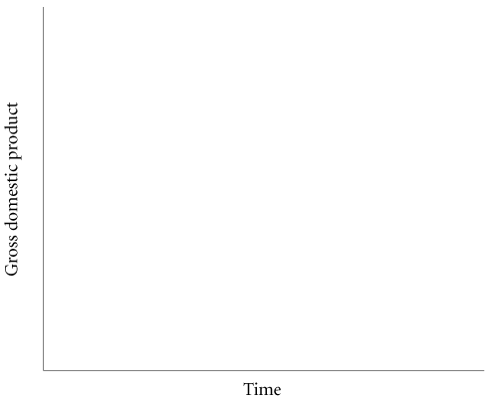
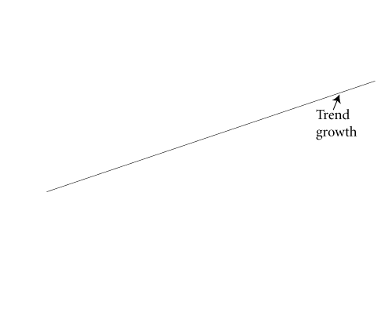

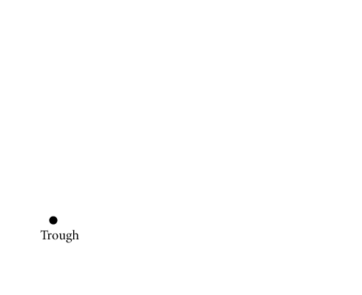
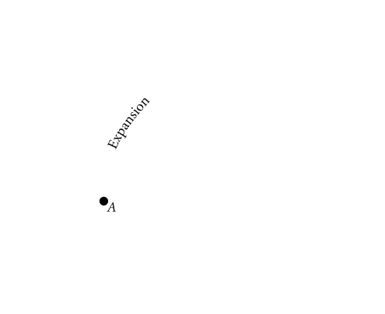
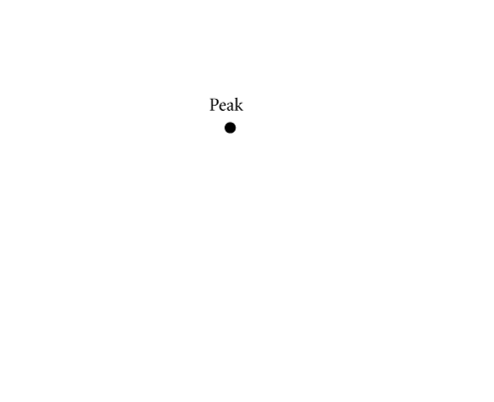
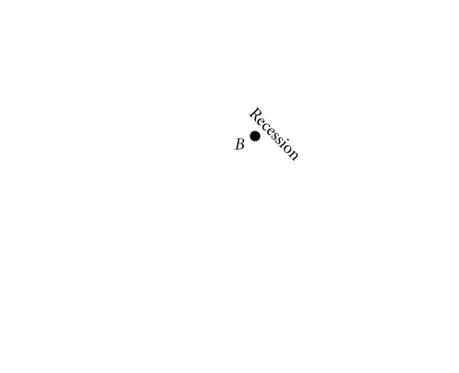
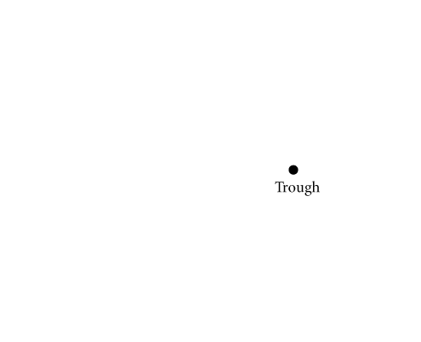
Output Growth
FIGURE 1 A Typical Business Cycle
In this business cycle, the economy is expanding as it moves through point A from the trough to the peak.
When the economy moves from a peak down to a trough, through point B, the economy is in recession.
Figure adapted from Case et al. (2013), Principles of Economics, Pearson
Notes:
Tools for controlling business cycles: macroeconomic policies –Fiscal policy, Monetary policy

Slide 13
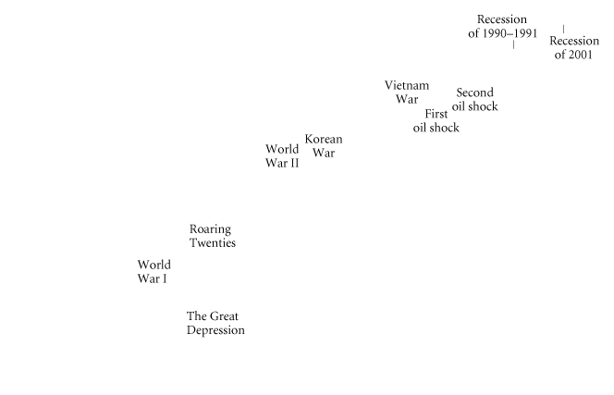
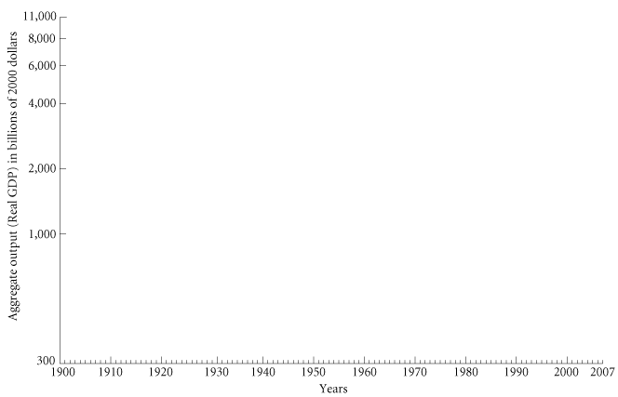
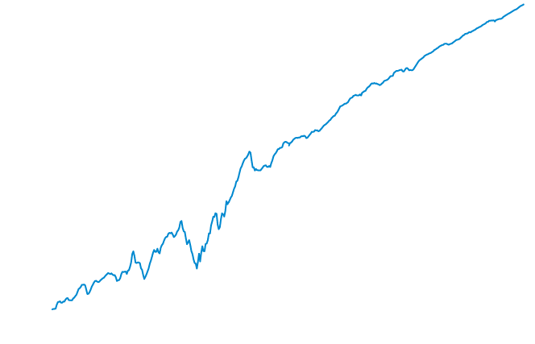
Output Growth
FIGURE 2 U.S. Aggregate Output (Real GDP), 1900–2007
The periods of the Great Depression and World Wars I and II show the largest fluctuations in aggregate output.
Figure adapted from Case et al. (2013), Principles of Economics, Pearson
Notes:
Eg. In 20th century, US economy has experienced one depression 1930s, and three severe recessions 1946, 1974-75, and 1980-82.

Slide 14
3) Issue of Inflation
Inflation is defined as persistent and considerable increase in the price level over a long period of time.
A moderate rate of inflation is considered to be desirable for the economy—2-3 percent for developed countries and 4-5 percent for developing economies.
Inflation in excess of these rates is economically and also socially undesirable, and is rather dangerous for the economy.
Notes:
The goal of policy makes is to avoid prolonged periods of inflation as well as deflation in order to bring stability.
Inflation is considered as a serious macroeconomic problem necessitating formulation of suitable policy measures and effective implementation of policy for controlling prices.
Questions asked in macroeconomic analysis: 1) What are the factors affecting inflation?
2)Why does inflation rate differ from time to time and from one country to other?
3) How to control for the rising prices?

Slide 15
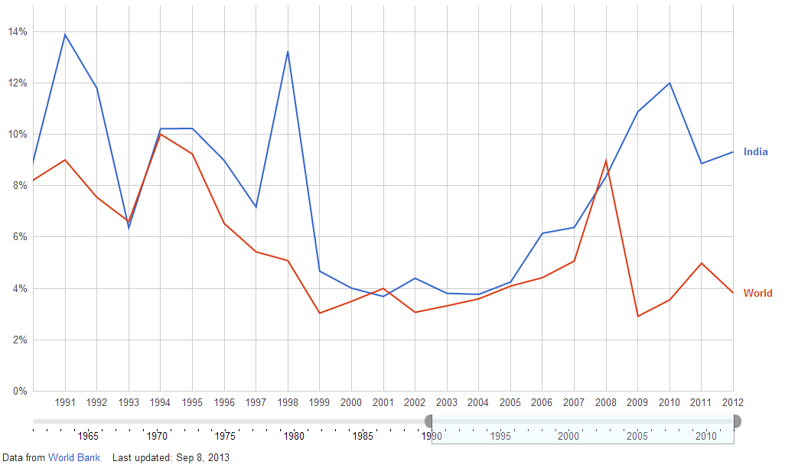
Inflation Rate (%)

Slide 16
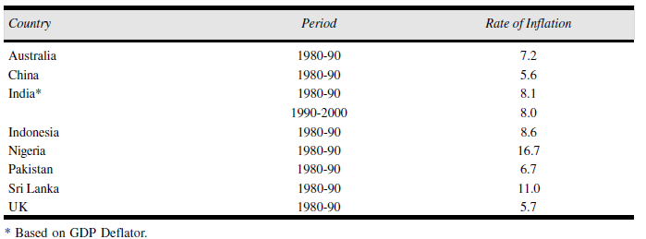
In April-September 2008, the inflation rate had varied between 10 percent and 13 percent despite a high growth rate of 9 percent in GDP. This had become a matter of great concern for both the RBI and the Finance Ministry.

Slide 17
4) The issue of Unemployment
Unemployment refers to that part of the labour force, or workforce, which is willing to work at the prevailing wage rate and is looking for a job but is not getting employment.
The level of unemployment in a country is measured in terms of percentage of out-of-job labour force to total labour force.
According to World Development Report (2004), unemployment rate in some countries was relatively very high, e.g., USA (5.8 percent), Japan (5.4 percent), and Australia (6.3 percent). Unemployment rate in Pakistan was very high (7.8 percent), India (3.06 percent).
Notes:
In commodity market, imbalance between demand and supply can be restored by increasing or decreasing prices, while in labour market, there is a downward wage rigidity. Wages cant be reduced to restore equilibrium. Macroeconomists are interested in learning why the unemployment rate has risen or fallen in a given period. We do not expect to bring unemployment at zero percent.

Slide 18
5) Issue of Budgetary Deficits
The government budget refers to the annual revenue and expenditure of the government of a country.
The use of government revenue and expenditure as weapons to solve macroeconomic problems of the country and to control and regulate the economy is called fiscal policy.
The budgetary deficit and budget management have emerged as the major macroeconomic problems for the government in India. The reason is that the government expenditure has been rising much faster than revenue.
Notes:
The problem of persistent budgetary deficit is faced by both developed and developing economies. Eg. Through 1970s to mid 1990s US economy faced this problem. UK faced this problem throughout after second world war.

Slide 19
6) International Economic Issues
(i) Growing balance of payments deficits,
(ii) Exchange rate fluctuation, i.e., rupee-dollar exchange rate in the market; and
(iii) Excessive inflow or outflow of capital, i.e., FDI

Slide 20

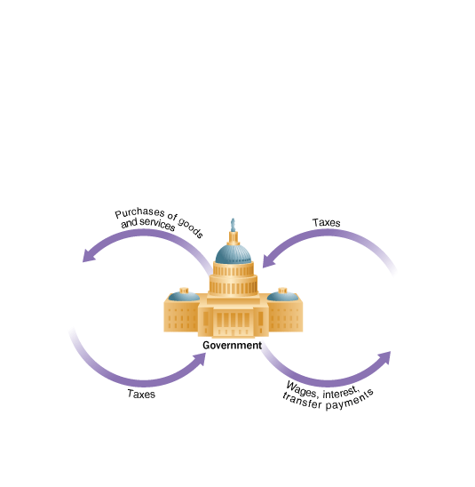
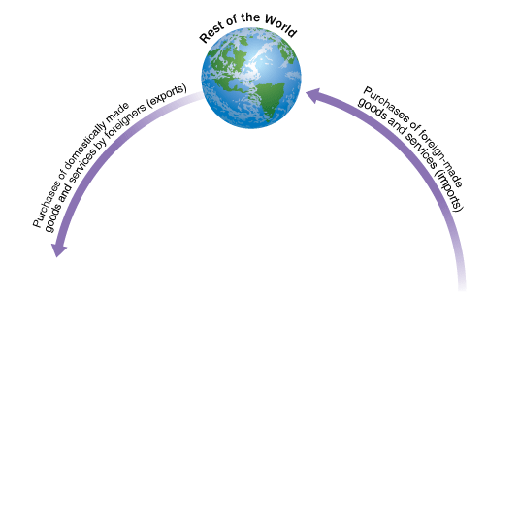
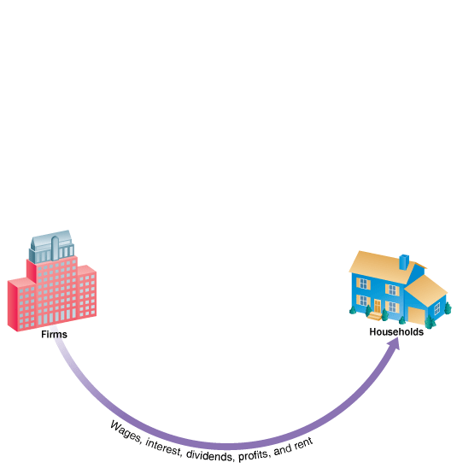
Income, Expenditure, and the Circular Flow
FIGURE 3 The Circular Flow of Payments
Households receive income from firms and the government, purchase goods and services from firms, and pay taxes to the government. They also purchase foreign-made goods and services (imports).
Firms receive payments from households and the government for goods and services; they pay wages, dividends, interest, and rents to households and taxes to the government.
The government receives taxes from firms and households, pays firms and households for goods and services—including wages to government workers—and pays interest and transfers to households.
Finally, people in other countries purchase goods and services produced domestically (exports). Note: Although not shown in this diagram, firms and governments also purchase imports.

Slide 21
STATIC, COMPARATIVE STATIC AND DYNAMIC ANALYSIS

Slide 22
Static Economics
Studies focusing only on particular point in time. It is concerned with explaining the determination of equilibrium values with a given set of data.
It is similar to taking a photo when you press the button for a shot then the photo is just at a particular point of time.
Most of the analysis in economics is of static nature. For instance, we say the market is in equilibrium when demand and supply equate one another, which is graphically represented by the intersection point of demand and supply curve. This is a static analysis since we just only see the picture at a point of time.
Merit:
This helps to keep analysis simple, manageable and at the same time useful, instructive as well as adequate enough to understand the crucial aspects of the changing phenomena.

Slide 23
Comparative Static
Comparative static analysis compares one equilibrium position with another when:
The data have changed and
The system has finally reached another equilibrium position.
It does not analyze the whole path as to how the system grows out from one equilibrium position to another when the data have changed.
It merely explains and compares the initial equilibrium position with the final one reached after the system has adjusted to a change in data.

Slide 24
Comparative Static -1
Comparative static is similar to taking photos at many different point of time.
Focuses on the external force that make the equilibrium in the model change.
The external force here refer to exogenous variables. In economics we have two types of variables: endogenous and exogenous variables. Endogenous mean any variable defined within the model whereas the exogenous variable refer to constant term or parameter where its value is defined outside the model.

Slide 25
Dynamic Economics
The word “dynamics’ means causing to move. In economics, it refers to the study of economic change. In economic static, the relations between the relevant variables refer to the same point or period of time. In economic dynamic, the relations between relevant variables refer to different point of time. It is, thus, a process of change through time.
Focuses on the change of time and how the equilibrium change with time. It explains how with a change in the data, the system gradually grows out from one equilibrium position to another.
It is the same as watching the movie you can see how the image animate and move. Dynamic analysis allow us to see the path of variable how the variable change with time.
Examples: Growth Models, Business Cycles and Economic Fluctuations

Slide 26
Dynamic Economics
Economic dynamic thus should embody functional relationships of variables with different dates appended to them. For instance:
C_{t} = f (Y_{t-1})
Where: C is consumption, Y is income and T is time

Slide 27
References
Chapter 20, Principles of Economics, Case et al.
Chapter 2, Macroeconomics, D.N. Dwivedi

